Slide 1
Scientific writing
a guide to effectively communicating how awesome you are

Slide 2
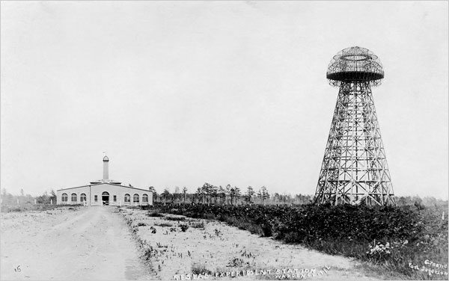
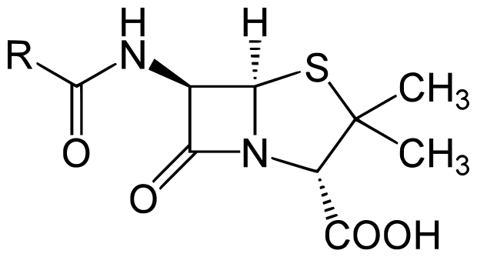
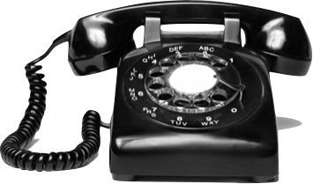

Successes and failures
Nikola Tesla
Alexander Fleming
Watson and Crick
Alexander Graham Bell
Elisha Gray
Penicillin, DNA, the telephone, and Wardenclyffe Tower

Slide 3
Why do we Write ?

Slide 4
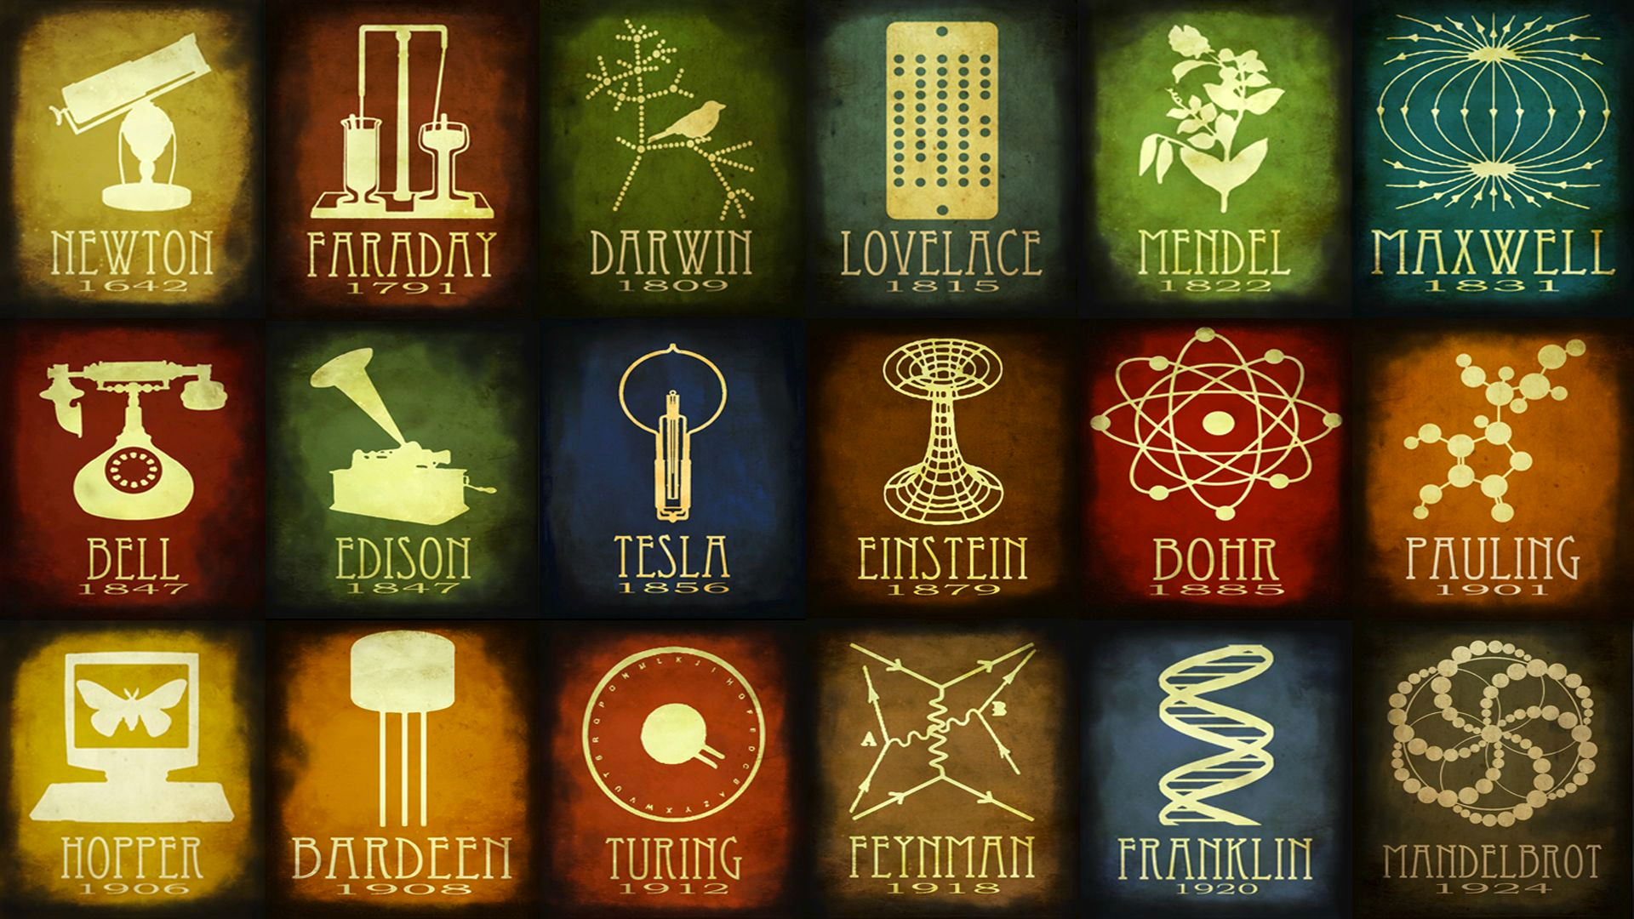

Slide 5
o.c.a.r.F.
Opportunity - something awesome is happening, exploit it
Challenge - it’s difficult though, why haven’t other people done it?
Action - what did you do that was so awesome?
Resolution - your result, and why it’s awesome
Future - how can we use your result to change the world

Slide 6
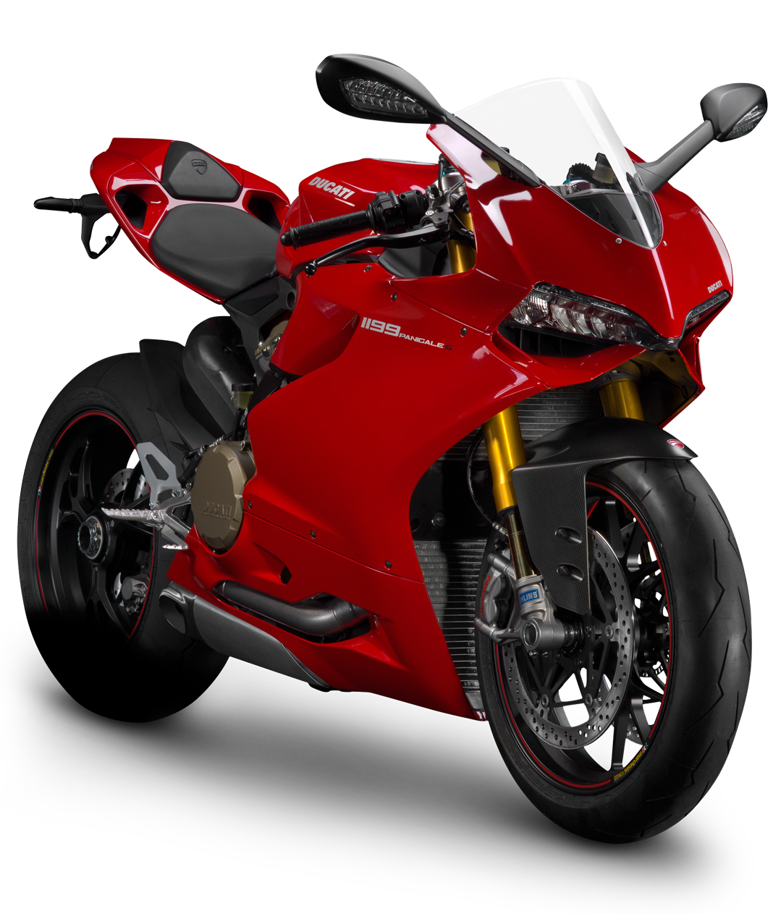
Example
Currently the automotive industry is at a turning point from gas to electric powered vehicles. With battery technology lacking, this burgeoning trend has not yet allowed motorcycles to adapt fully electric engines. Here, a design is presented for an ultra long-life Lithium ion battery. Our revolutionary battery will allow the development of higher power wireless technologies and engines, dramatically improving mobile device longevity and portability.

Slide 7
Your turn!

Slide 8
“If we knew what it was we were doing, it would not be called research, would it?”
— Albert Einstein

